Slide 1
1
Wat is Reclame?

Slide 2



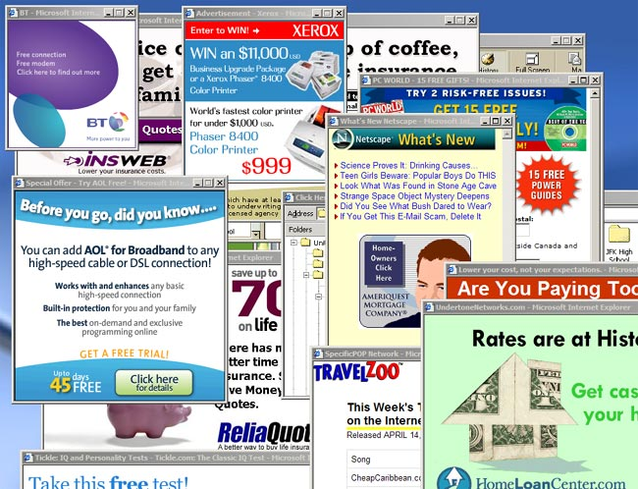
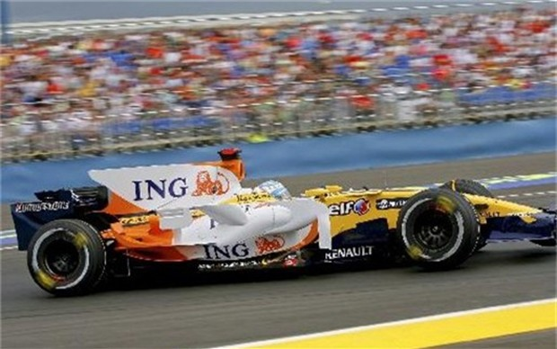
RECLAME OM ONS HEEN
Notes:
BRONNEN afbeeldingen:
Reclamfolder: http://blokker.gratisbrochures.be/blokker-reclamefolder-tot-12-05-13
Sponsoring: http://www.hbvl.be/nieuws/economie/belga/extern-ing-stopt-met-sponsoring-formule-1.aspx
Pop-up ads: http://en.wikipedia.org/wiki/Pop-up_ad
Tv: http://www.iconarchive.com/show/oxygen-icons-by-oxygen-icons.org/Devices-video-television-icon.html
Radio: http://openclipart.org/image/300px/svg_to_png/18993/AJ_simple_radio.png

